Slide 1


Riccardo BONAFEDE
Università di Padova
Logic Vulnerabilities
https://cybersecnatlab.it

Slide 2

License & Disclaimer
License Information
Disclaimer
This presentation is licensed under the Creative Commons BY-NC License
To view a copy of the license, visit:
http://creativecommons.org/licenses/by-nc/3.0/legalcode
We disclaim any warranties or representations as to the accuracy or completeness of this material.
Materials are provided “as is” without warranty of any kind, either express or implied, including without limitation, warranties of merchantability, fitness for a particular purpose, and non-infringement.
Under no circumstances shall we be liable for any loss, damage, liability or expense incurred or suffered which is claimed to have resulted from use of this material.

Slide 3
Goal
Learn how to find and address high level logic errors
Learn how to analyse permissions in web applications
Learn how to analyse functionalities and logic flaws in web applications

Slide 4
Prerequisites
Lecture:
WS_1.1 - HTTP Protocol and Web-Security Overview

Slide 5
Outline
Introduction
Access-Control logic vulnerabilities
IDOR
Incorrect input

Slide 6
Outline
Introduction
Access-Control logic vulnerabilities
IDOR
Incorrect input

Slide 7
Introduction
Business logic vulnerabilities are flaws in the design of an application that let users cause unintended behaviors
These flaws often based on wrong assumptions about the user’s behaviors

Slide 8
Types of Logic Vulnerabilities
Logic Vulnerabilities are specific to the applications in which they occur
The best way to group them is by the root cause:
Access Control Issues
Wrong assumption of the user behavior
Flawed handling of an Incorrect input
…

Slide 9
Outline
Introduction
Access-Control logic vulnerabilities
IDOR
Incorrect input

Slide 10
Unprotected Functionality
The most common type of access control issues are the one caused by a wrong implementation of the authentication system
We call these type of issues «Unprotected Functionality»

Slide 11
Unprotected Functionality
Unprotected Functionality flaws arise when the web application does not properly check user’s privileges
A trivial example is an administration api that does not enforce the privilege required by the user

Slide 12
Unprotected Functionality
The best way to find these vulnerabilities is to try to use them without the required privilege
For more complex web applications, with different privilege levels, is it possible to use an authentication matrix:
For every privilege level, create two or more users
For every user, test every functionality and save the result
Now, you can see the matrix created with the result, and it’s easy to spot problems
AuthMatrix¹ is a burp plugin to automate this type of testing
1: https://github.com/PortSwigger/auth-matrix

Slide 13
Unprotected Functionality
It is also possible that the authentication is present, but is not enforced correctly
This happens when the access control is not enforced by the functionality itself, but by some other system, for example by the web server itself

Slide 14
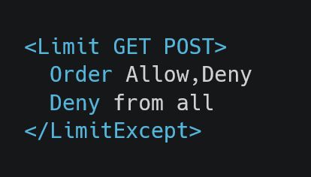
Unprotected Functionality
For example, the functionality can be accessed in different ways, in which the authentication is not enforced
Limit every request that is using a GET or POST method

Slide 15
Unprotected Functionality
Route-based limiting can also be bypassed
Exploit path normalization
/api/v1/user_info == /api/v1/foo/..;/user_info
Framework-dependent behaviors
For example, in applications written using the ruby on rails web-application framework it is possible to append “.json” to a route. Often, developers forget to check the authentication on these paths

Slide 16
Outline
Introduction
Access-Control logic vulnerabilities
IDOR
Incorrect input

Slide 17
Unprotected Functionality - IDOR
IDOR – Insecure Direct Object Reference
One of the most common flaws in web applications
Arises when user input is used to access data directly and no authorization is enforced
Permits a horizontal privilege escalation

Slide 18
Unprotected Functionality - IDOR
An example from “Vimeo.com Insecure Direct Object References Reset Password”¹
When resetting a password, Vimeo sends a reset link to the user email
The link is in the form:
https://vimeo.com/forgot_password/[user_id]/[token]
1: https://hackerone.com/reports/42587

Slide 19
Unprotected Functionality - IDOR
user_id is the id of the user that requests the password change
token is a one time secret that Vimeo uses to verify the identity of the user that requests the password change
What if the token was not linked to the user_id ?

Slide 20
Unprotected Functionality - IDOR
Changing the user-id permits to change other users password, because the token is still valid
https://vimeo.com/forgot_password/1234567/7aaor252m19kjtkvtr
https://vimeo.com/forgot_password/9876543/7aaor252m19kjtkvtr

Slide 21
Unprotected Functionality - IDOR
To find IDORs:
Look at the request’s parameters
If you find something that can be a reference, try to change it

Slide 22
Outline
Introduction
Access-Control logic vulnerabilities
IDOR
Incorrect input

Slide 23
Incorrect Input Handling
Other types of logic flaws arise when a malicious user can provide a wrong input type to a web app
A lot of developers assume that the input type can be enforced client-side

Slide 24
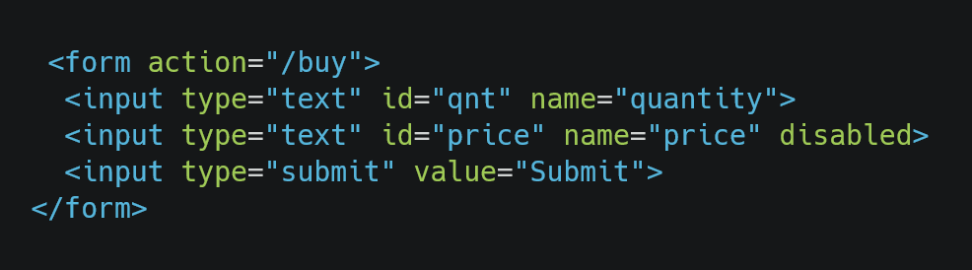
Incorrect Input Handling
For example, if a textbox is disabled doesn’t mean that an attacker can send that parameter to the server

Slide 25
Incorrect Input Handling
But, as you may know at this point, it is trivial to provide arbitrary values to the server by making a raw request
If the web application does not handle this input correctly, then logic flaws may arise

Slide 26
Incorrect Input Handling
A real-world example is provided in the report https://hackerone.com/reports/364843
Using this kind of flaw, a researcher found a vulnerability in the site upserve.com, a “Restaurant Management Software”

Slide 27
Incorrect Input
The vulnerable function works as follows:
A user add some items to its personal cart
Completed the order, the user can finalize the payment
The final price was calculated by summing the total cost of each different items multiplied the desired quantity

Slide 28
Incorrect Input
The app was flawed; in fact, it didn’t expect a negative value in the quantity of an item
Because of this, it was possible to get a “discount” on the final price
To do so, the attacker needs to buy some products, then add a negative value to the quantity of one of the items

Slide 29
Incorrect Input
If the quantity of a product is negative, then its cost is subtracted from the total
This was possible because the web app didn’t expect a negative value:
"name": "BreadPudding", "price": 900, "quantity": -1

Slide 30
Riccardo BONAFEDE
Università di Padova
Logic Vulnerabilities
https://cybersecnatlab.it

